Slide 1

IST 652 | Final Project Presentation
Twitter Analysis of Potential Bitcoin and Ethereum Scams
Matthew L. Pergolski
Syracuse University

Slide 2
Agenda
Background/Context
Data Source
Preprocessing & Preliminary Steps
Exploring Data Questions
Identifying Unique Project Components
Conclusions
Q&A

Slide 3
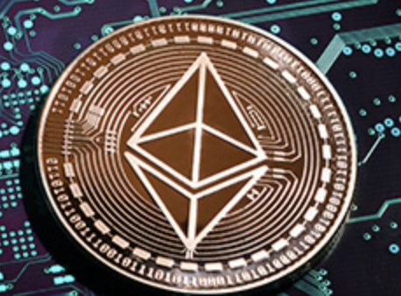
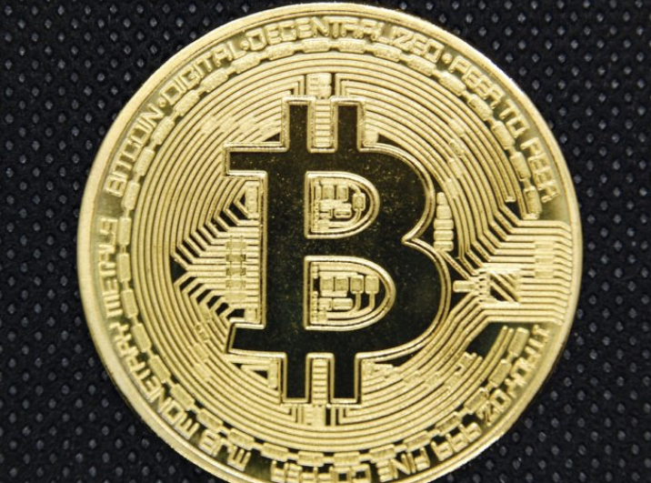
Background/Context
Cryptocurrency
Bitcoin (#BTC)
Ethereum (#ETH)
Twitter
Relevancy in 2022
Acquisition Lawsuit with Elon Musk
Project Objective
Explore data questions related to cryptocurrency searches on Twitter

Slide 4

Data Source
Tweepy Package
API.search_tweets method
Returns a collection of relevant Tweets matching a specified query.
Twitter’s standard search API only “searches against a sampling of recent Tweets published in the past 7 days.”
JSON format

Slide 5
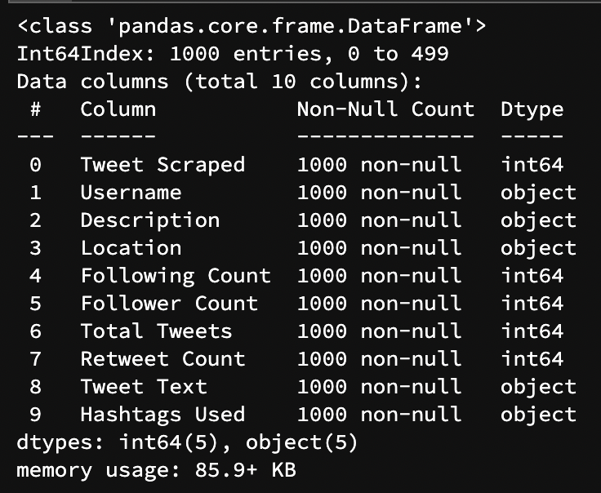
Preprocessing & Preliminary Steps
Twitter developer account required with ‘Elevated’ or ‘Educational’ access
API_KEY, API_KEY_SECRET, BEARER_TOKEN, ACCESS_TOKEN, ACCESS_TOKEN_SECRET
Configuration file; .ini extension
Establish connection to the Tweepy API
Gather account fields for use within analysis
Transform JSON exports to Pandas data frames
Combine data frames for #BTC, #ETH
Tweet sample: 1,000 (500 #BTC + 500 #ETH)

Slide 6
Exploring Data Questions
What are the Twitter Summary Statistics of the Sampled Users?
Who is the Most Followed Account from the Tweet Sample?
Which Locations are the Users Tweeting From?
What Percentage of the Sampled Tweets Contain the Terms 'Giveaway', 'Contest', or 'Prize’?
What is the Overall Sentiment of the Tweet Sample?

Slide 7
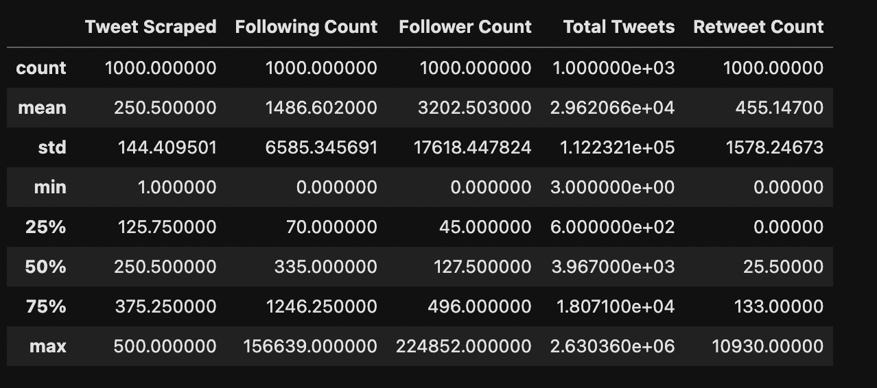
What are the Twitter Summary Statistics of the Sampled Users?

Slide 8
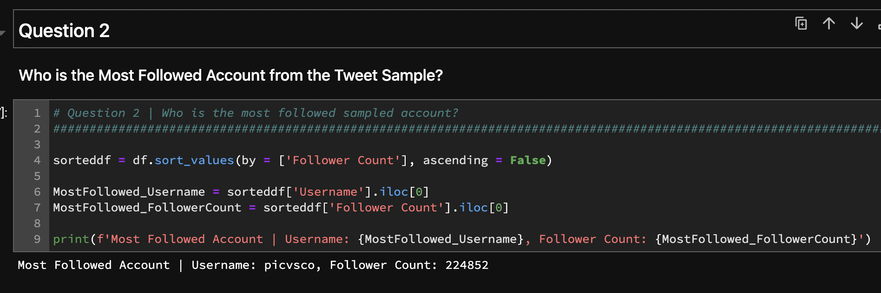
Who is the Most Followed Account from the Tweet Sample?

Slide 9
Which Locations are the Users Tweeting From?

Slide 10
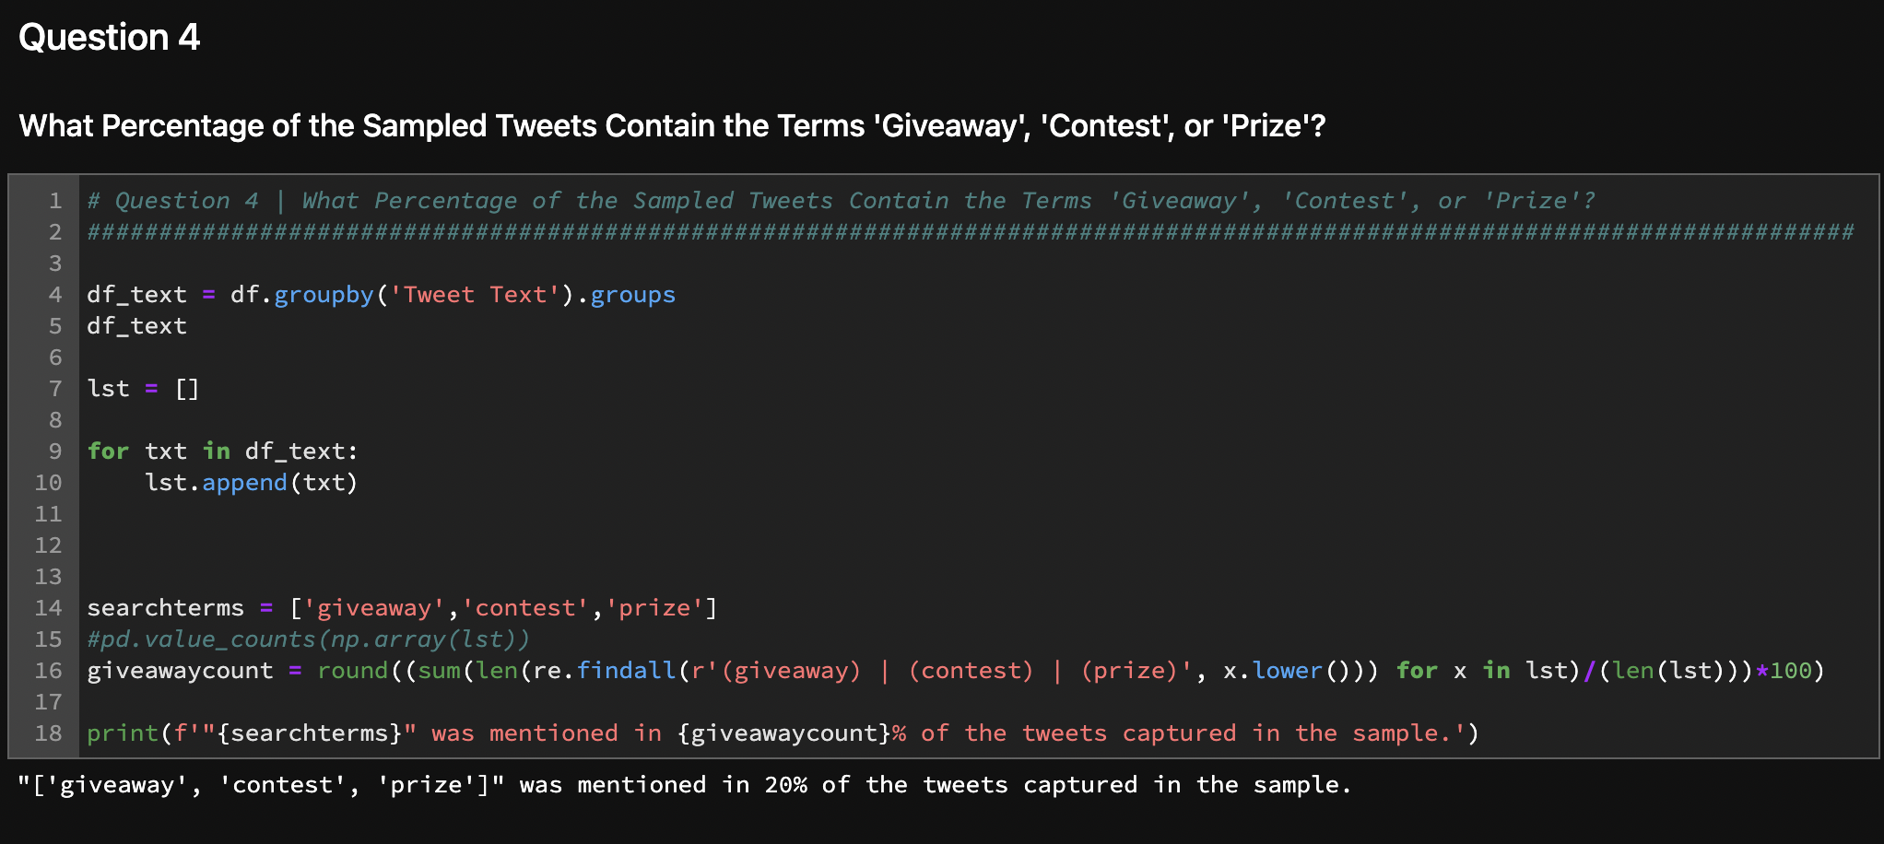
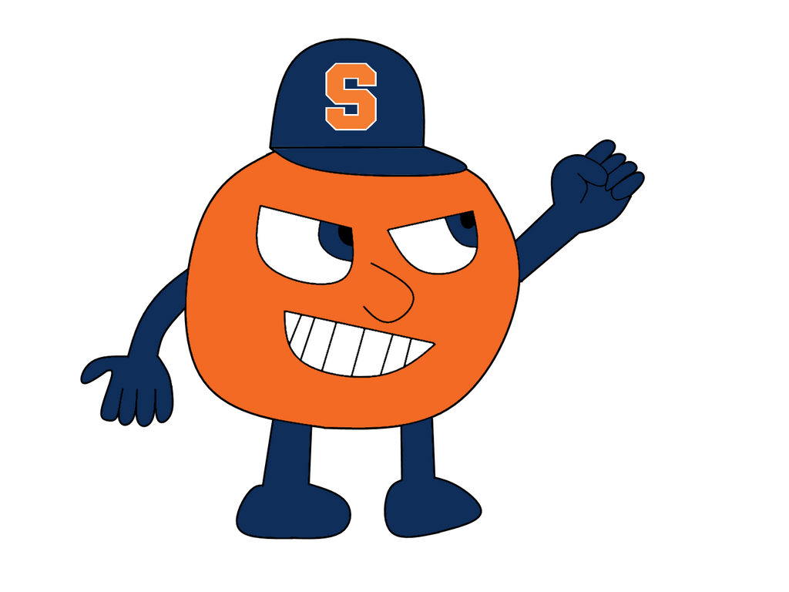
What Percentage of the Sampled Tweets Contain the Terms 'Giveaway', 'Contest', or 'Prize’?
Tweet Text fields appended to separate list
Words converted to lower case
Regular expressions package (i.e., re) utilized to identify the terms ‘giveaway’, ‘contest’, and/or ‘prize’ in list of text strings
Assumptions made: Tweet Texts with any of the above terms are evidence of spam/bot accounts
Findings:
20% of tweets contained search terms of interest

Slide 11
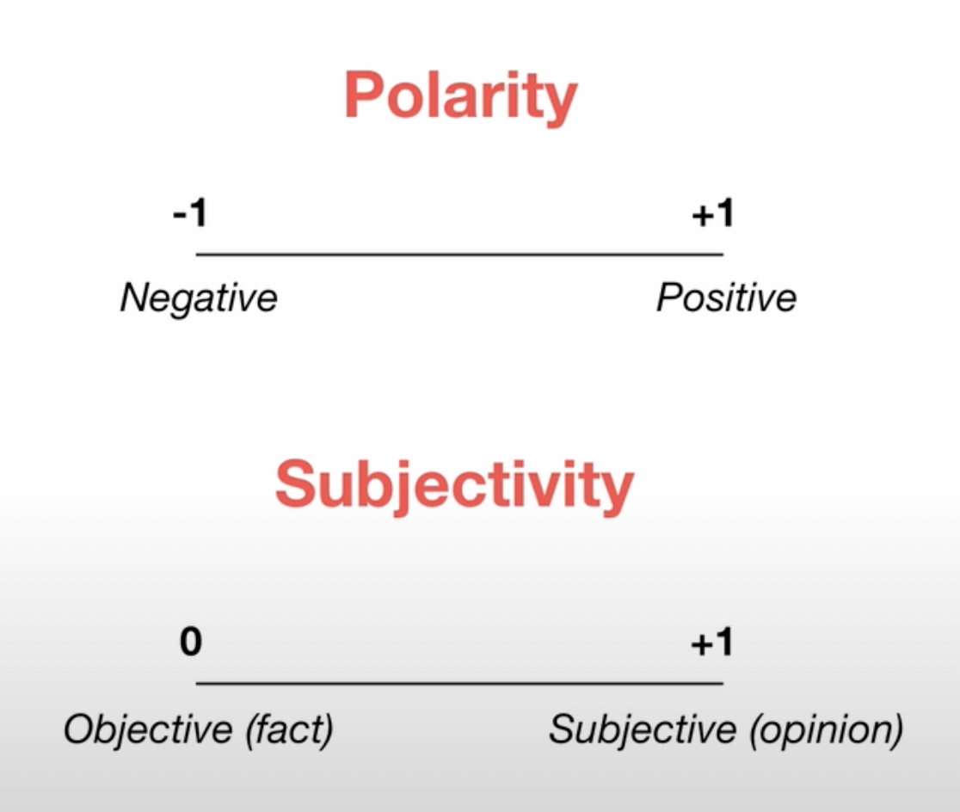
What is the Overall Sentiment of the Tweet Sample?
Utilized TextBlob to calculate polarity and sentiment scores
Average Polarity Score: 0.0833704375225469
Average Subjectivity Score: 0.21137566322566323

Slide 12
Identifying Unique Project Components
Use of configuration file to maintain privacy of Twitter Developer Account tokens
Use of ‘ipywidgets’ package to provide dialog box-like experience for choosing .ini, .json files for analysis
Combining data sets on two topics of twitter data: Bitcoin & Ethereum
Providing average sentiment scores for collected tweet text data

Slide 13
Conclusions
Overall ‘potential’ bot activity in sample: 20%
Interesting ties back to Twitter/Elon Musk lawsuit
Twitter indicates only 5% of activity is related to bots/scam accounts
Elon Musk suggests perhaps 50+%
Although one sample is an interesting event, more samples and statistical tests would be needed to confirm statistical significance
True bot activity could lie somewhere in between Twitter and Musk’s estimates/claims

Slide 14
Summary
Background/Context
Data Source
Preprocessing & Preliminary Steps
Exploring Data Questions
Identifying Unique Project Components
Conclusions

Slide 15

Q&A

